Slide 1
CMP_SC 3380 Final project Group 18
Reconstruction of the Student Unions website.

Slide 2
Overview
Cascade Server
No SSL Available
Replacement CMS
Unions Admin Portal
Lost & Found Module
User Management

Slide 3
Technologies
Languages Used: PHP 5.5.6, jQuery, jQuery UI, Twitter Bootstrap, SOAP/XML
Databases: PostgreSQL and SQL Server
Version Control: GIT on Github
Framework: Yii 1.1 (MVC)
Web Server: Apache
Tools: PhpStorm, SourceTree, pgAdmin3

Slide 4
Datasets Utilized
EMS API
Event Management System for the Missouri Student Unions
Event Spaces & Meeting Times
PostgresSQL Database
Lost & Found
Policies & Procedures
Event Space Features and Building Attractions

Slide 5
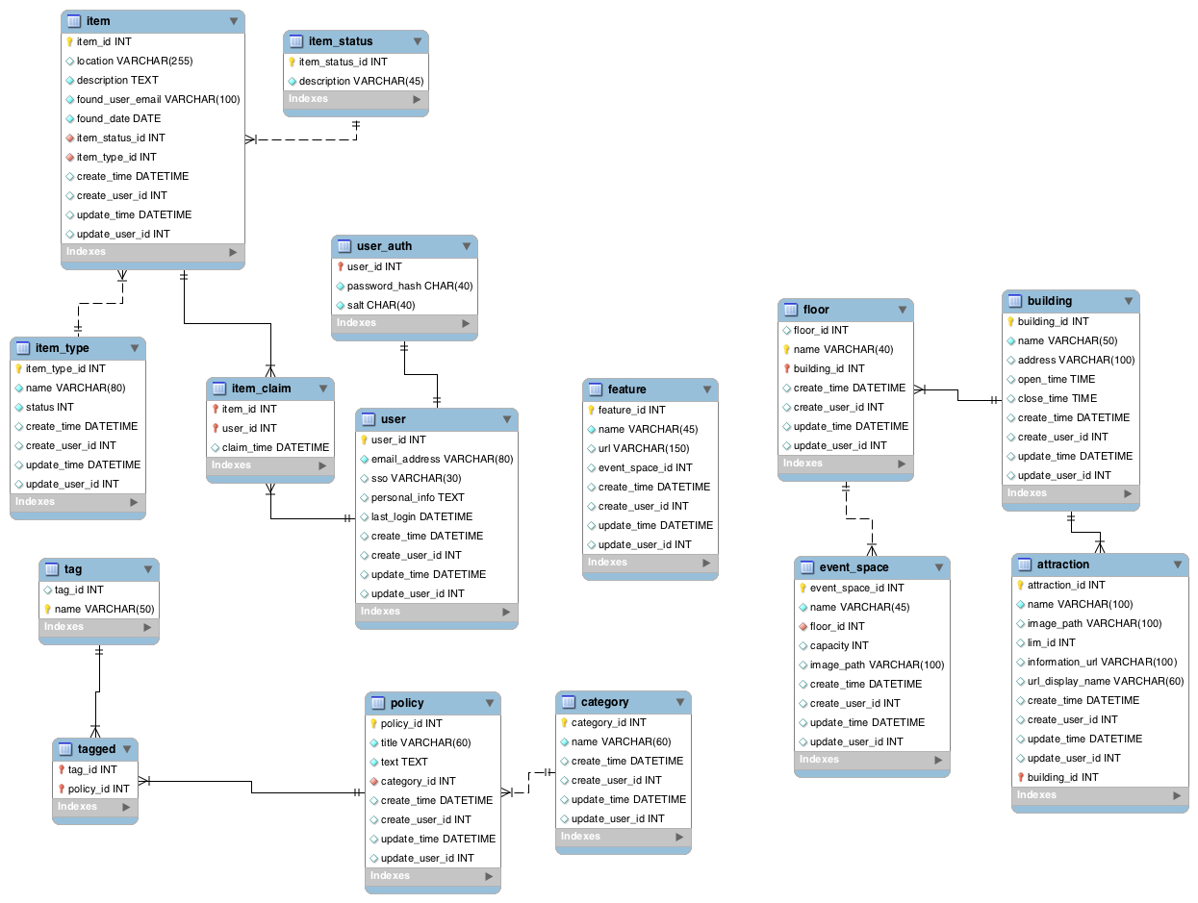

Slide 6
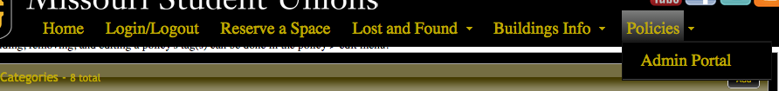
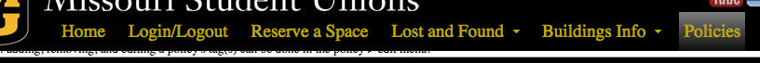
PHP5
JQuery
JQuery UI
Custom JQuery UI Theme
Custom Menu
“Scroll then Sticky”
Animations
Ability to hide
or show based on admin status

Slide 7
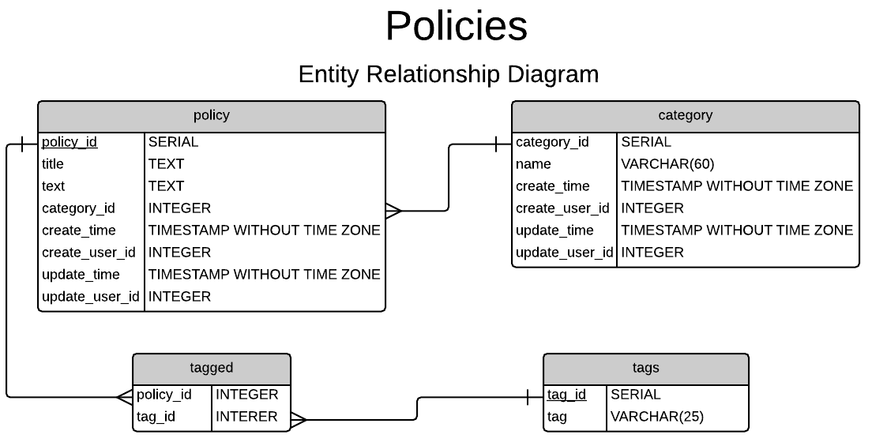

Slide 8
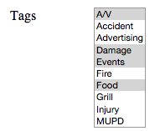
Adding/removing tag(s) from policies.
foreach (item in new_array) {
check if not in old_array
}
foreach (item in old_array) {
check if not in new_array
}
INSERT item INTO tag table
DELETE item FROM tag table
new_array
old_array

Slide 9
Lost and Found Module
Requested by the University
LDAP credential connections
Cross referenced tables for item id and status’
Item types became a challenge
Lost Item Types
Common types (Phone, Laptop, Jacket)
Uncommon (Food, Wife)
Option for new types
Admin Approval
Admin interface

